Slide 1
Construction
Work
Tasters – Employer Pack
Construction Work Tasters

Slide 2
OVERVIEW
½ day – 2 days
Construction Work Tasters are a shortened version of a traditional work experience week, where young people spend time in a working environment and learn about job roles and career opportunities.
On site / in a work
environment
Led by the employer
Construction Work Tasters

Slide 3
OVERVIEW
Aim:
Introduce young people to the full breadth of job roles and careers in construction
Traditional Roles
Professional Roles
Digital Roles
Green Roles
Work Tasters can focus on the entire spectrum of job roles and career paths in the construction sector.
Construction Work Tasters

Slide 4
OVERVIEW
Work Tasters support industry with recruitment challenges
Young people will be more informed about different job roles and will hopefully be less likely to drop out of apprenticeships or jobs due to them not matching expectations.
The sector needs young people with the widest range of skillsets and interests to match the increased diversity of job roles in construction.
Work Tasters are an opportunity to improve young people’s perceptions of the construction sector.
Construction Work Tasters

Slide 5
OVERVIEW
Apprenticeship & College Applicants:
Will benefit from seeing what different jobs look like in practice before beginning an apprenticeship or college course. More informed decisions will hopefully result in lower dropout rates due to job roles not matching expectations.
Students in School, College or University:
Who haven’t decided on a career will benefit from being introduced to a sector they might know nothing to little about. They might not be aware of all the job roles in construction; many of those job roles might perfectly suit their interests and career ambitions.
Hard to Reach Young People & Underrepresented Groups:
Will be able to easily access Work Taster opportunities. The Construction Work Tasters project is being delivered in partnership with local authorities, public sector bodies and third sector partners.
Career Changers:
Will be able to access opportunities to discover construction sector roles. Many people enter the sector through connections with friends and family who already work in construction. Work Tasters can open the door to people who don’t have connections.
Construction Work Tasters are aimed at 16 to 25-year-olds.
Construction Work Tasters

Slide 6
Current
Future
Young person with no insight into the day-to-day activities of certain job roles
For young people who are already interested in a career in construction, a Work Taster will allow them to make a more informed decision about the role which is right for them.
Starts apprenticeship / college course
Attends Construction Work Taster(s)
Expectations do not match – greater chance of that young person leaving the sector
Makes more informed decision about apprenticeship / college course
More likely to complete qualification and remain in the sector
Construction Work Tasters

Slide 7
Current
Future
Young person with no interest in construction
For young people who are not interested in a career in construction, a Work Taster will allow them to have a better understanding of the many job roles which exist. Some of those job roles might perfectly suit their interests and career ambitions.
Goes on to work in other sectors
Attends Construction Work Taster(s)
Attends one-week work experience placement in construction sector
Is more aware of the opportunities within the construction sector
Starts an apprenticeship, college course or university degree in a construction-related discipline
Goes on to work in the construction sector
Construction Work Tasters

Slide 8
OVERVIEW
Work Tasters can support with existing community benefit activities and targets.
They are a measurable activity in the SFT TOMs under the ‘improved employability’ outcome.
Construction Work Tasters

Slide 9
OVERVIEW
Work Tasters are not a new activity. There are already a lot of great examples of employers running work tasters in the construction sector.
Our aim is to learn from those activities and to develop a high-quality Work Taster model which can support the wider construction sector.
DYW will gather robust data on the effectiveness of Work Tasters. That data will be used to improve the Work Taster model; those learnings will be shared with employers. By working closely with industry, we can change the perceptions and attitudes which young people hold about the construction sector.
Delivery of Work Tasters
Participant & Employer Feedback
Learnings Shared with Employers
Work Taster Model Improved
Construction Work Tasters

Slide 10
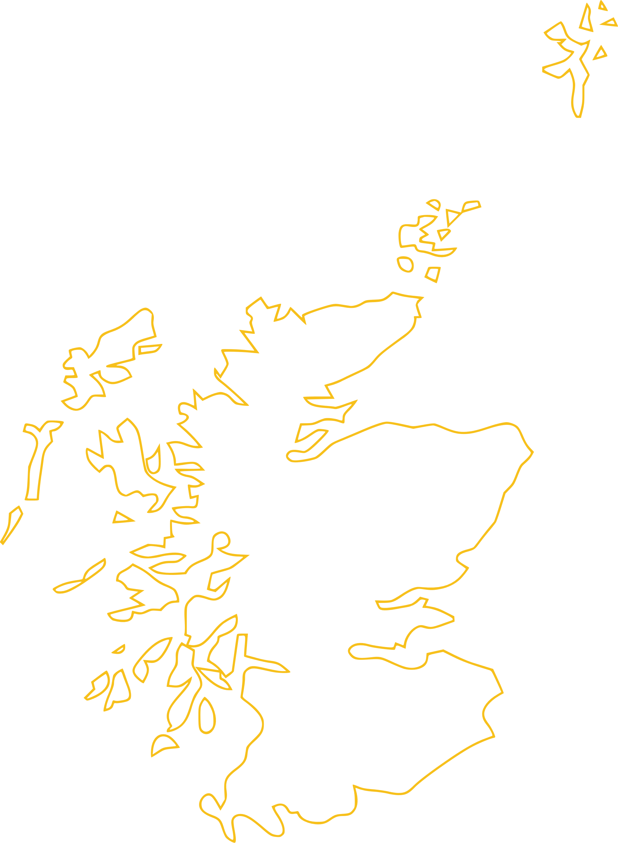
OVERVIEW
This is a Scotland-wide project.
The Work Taster model will be used to support more employers to engage with young people.
Work Tasters are already running, and we want to work with more employers to run sessions from now until March.
Together, we will use the learnings from those initial sessions to develop the Work Taster model, which will be launched in Spring 2023.
Construction Work Tasters

Slide 11
NEXT STEPS
Steps to run a Work Taster:
Choose locations & dates
Decide on how many young for each session
Create an itinerary (examples on next slide)
Contact DYW who can identify young people for your sessions
To support the project at this stage, contact DYW at conor.moran@edinburghchamber.co.uk
Construction Work Tasters

Slide 12
EXAMPLE ITINERARIES
 | Large construction site focusing on various construction roles | Office-based focusing on professional roles | Small, local employer focusing on one or two specific roles
9am | Intro, registration, H&S induction, PPE provided | Intro, registration, H&S induction, PPE provided | Intro, registration, H&S induction, PPE provided
 | Site tour & explanation of job roles | Office tour & meet staff from different departments | Social media task introduced (e.g., video diary of a Work Taster with example co. )
 | Meet subcontractors | Presentations on job opportunities and pathways, including Q&A session with current apprentices | Job shadowing
 | Lunch |  | Lunch
 | Practical / digital activity for group | Lunch & networking | Job shadowing & practical activity
 |  | Job shadowing
 | Mock interviews | CV development and interview prep | CV & interview guidance
4pm | Evaluation & plan follow-up work experience with those interested | End of day Q&A and evaluation | End of day review, inc. young person sharing what they’ve learnt
Construction Work Tasters

Slide 13
NEXT STEPS
By working together, we can develop a model which encourages more young people to join the construction sector.
We want to work with as many employers as possible to develop a model which is as effective as possible.
If you would like to be involved or have any questions, please contact conor.moran@edinburghchamber.co.uk
Construction Work Tasters

